Slide 1

How Should Innovation Policies Be Adapted To Local Economic Conditions?
An Agent-Based Analysis
Herbert Dawid, Simon Gemkow, Philipp Harting,
Bielefeld University
Michael Neugart
Free University of Bozen-Bolzano

Slide 2


Motivation
Generation and diffusion of innovations is one of the main factors influencing (local) economic growth (e.g. Maddison (1991), Freeman (1994)).
Major policy issue in the EU: Lisbon Strategy
‘EU should become the most competitive and dynamic knowledge based economy’
Main attention is paid to two policy fields:
  Investing in human capital
  Strengthening R&D activities

Slide 3
Motivation
Recent theoretical work and empirical evidence suggests that effects of different policy measures on (long-run) growth rate is influenced by the distance of an economy to the technological frontier (e.g. Vandenbussche et al., 2006).
EU countries differ significantly with respect to composition of human and physical capital stock corresponding to different distances to the technological frontier.
Significant differences in this respect exist in particular between ‚old‘ and ‚new‘ EU member countries.

Slide 4
Research Questions
How do the effects of general skill vs. R&D improving policies compare between economies resembling ‘old’ and ‘new’ EU members?
How do short- and long run effects of different policies differ?
Does it matter for policy effects whether distance to the frontier is due to human or physical capital gaps?

Slide 5
Related Literature
Catch-Up Hypothesis: Gerschenkron (1962), Nelson and Phelps (1962)
Empirical Work on Human Capital and Productivity: e.g. Benhabib and Spiegel (1994, 2005), Hall and Jones (1999)
Irrelevance Result: Krueger and Lindahl (2001)
Increasing Imitative Skills vs. Increasing R&D: Vandenbussche et al. (2006), Aghion et al. (2009)
ACE Models of technological change and growth (e.g. Dosi et al. (2009), Silverberg and Verspagen (1995), see survey in Dawid (2006))

Slide 6
Strategy for the Analysis of Model Dynamics and Policy Experiments
Calibration of key parameters using empirical data and checking ability of the model to reproduce ‘stylized facts’.
Running simulation batches for different policy interventions.
Formulating hypotheses about the effect of policy induced parameter changes.
Carrying out statistical tests to check significance of the hypothesized effects.
Gaining a qualitative understanding of the relevant economic mechanisms responsible for the observed phenomena by examining evolution of key variables.
Notes:
(e.g. mark-ups, capital-intensity, capital depreciation, on the job search intensity, reservation wage adaptation …).

Slide 7
Old vs. New EU Members
Several differences in key economic variables between ‚typical‘ old member (Germany) and new member (Poland) are captured:
  General skill distributions (5 IALS levels)
  Specific skill levels of workers
  Quality of physical capital stock
  Size of per capita physical capital stock
This implies:
  Different distances to the frontier
  Different initial wages, per capita income etc.

Slide 8


Setup of the policy experiment
Consider 3 levels of distribution of general skills:
  Low: current distribution in new member country
  Medium: current distribution in old member country
  High: fictitious distribution where majority has skill level 5.
Benchmark annual growth rate of technological frontier: 1.4%
3 Policy Measures:
  HC: Upgrade general skill distribution
  R&D: Increase speed of technological frontier (1.4% -> 3.5%)
  Only for new member: Adjust quality of physical capital stock to that of old member

Slide 9
Setup of Policy Experiment
HC and R&D policies are applied in new and old member country economies.
20 runs for 250 months carried out for each scenario (policies are applied after 50 months transient period)
Time series of ratio of average (real) output with and without application policy are compared for both types of economies.

Slide 10
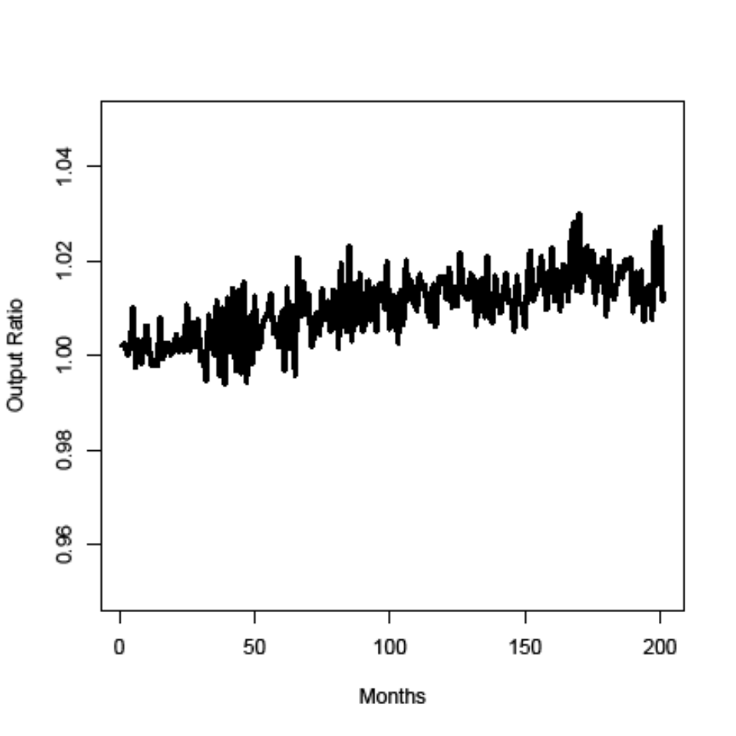
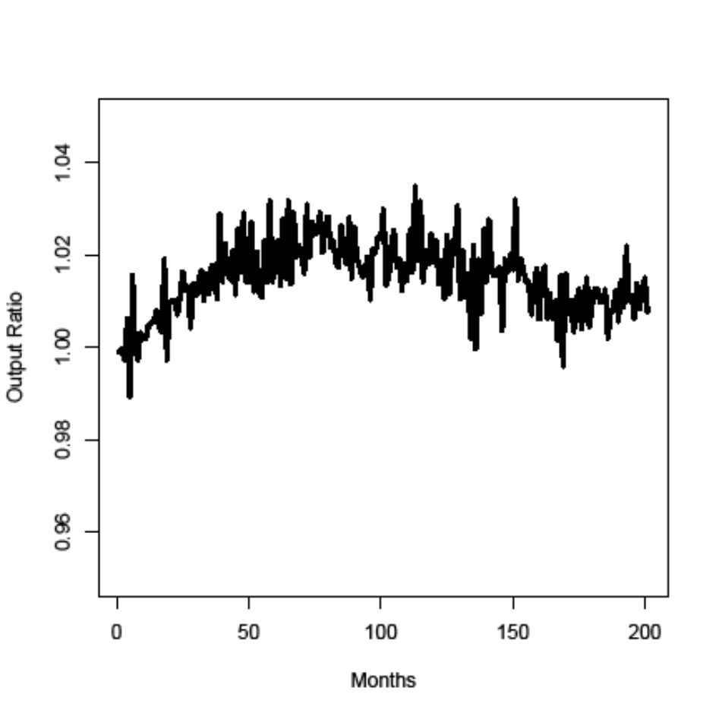
Human Capital Upgrading
medium->high for old member low-medium for new member

Slide 11
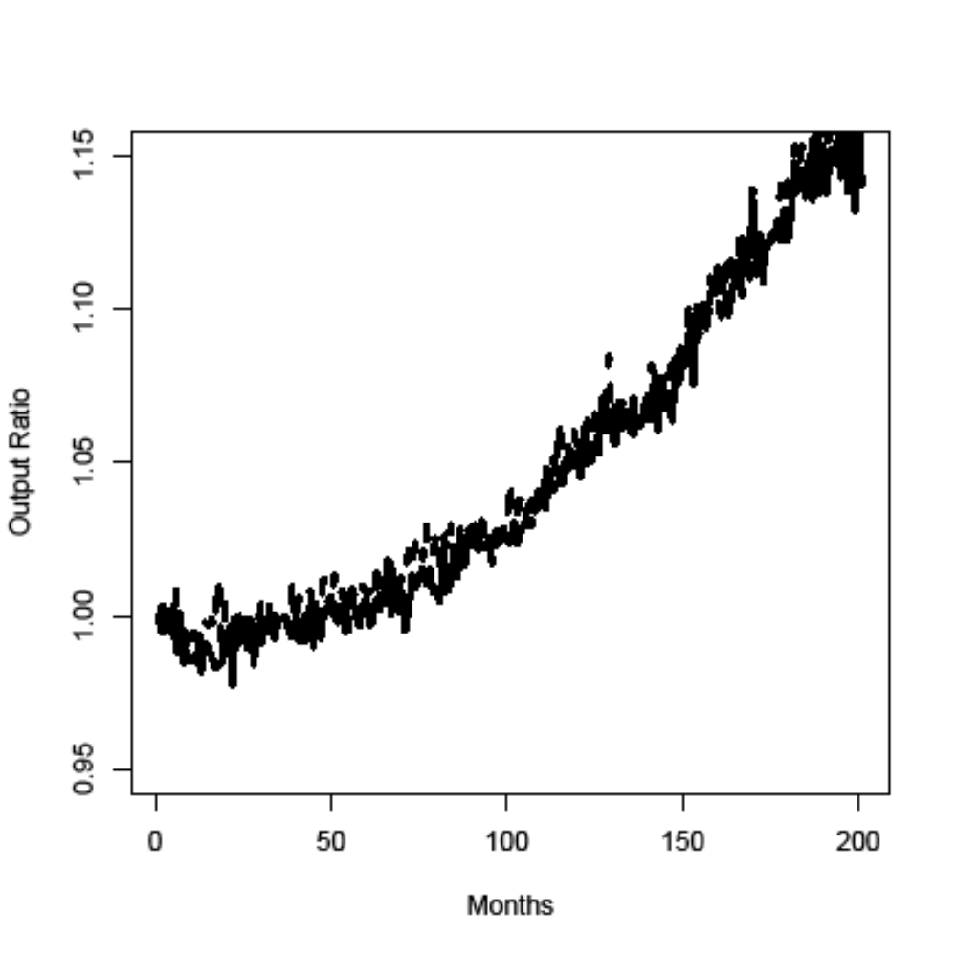
Effects of R&D Policy
old member (solid), new member (dashed)

Slide 12
Comparison of HC Policies
New and old member countries differ both with respect to physical and human captial.
When comparing HC policies different types of skill upgrading effects have to be compared (medium-> high vs. low-> medium).
To allow for direct comparison thought experiment is carried out:
  Compare effects of medium -> high for economies whose physical capital endowment is characterized by old vs. new member economies.

Slide 13
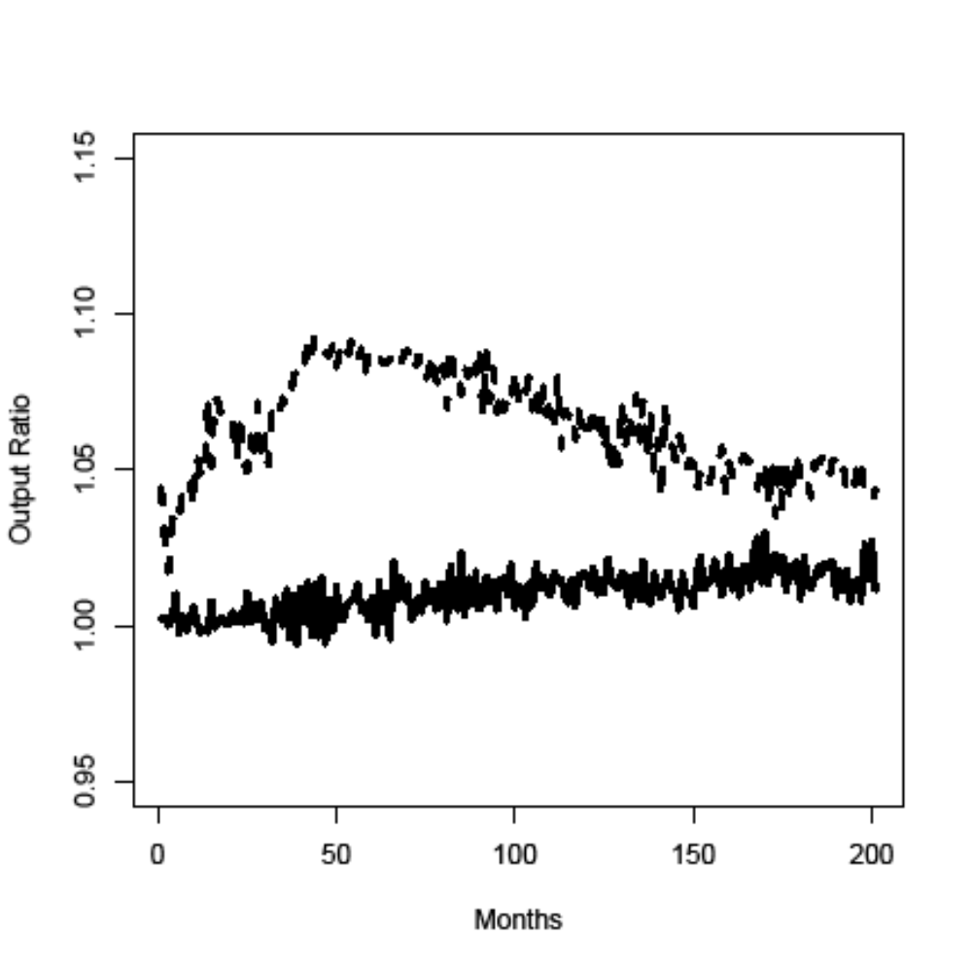
Comparison of identical HC Policies
effect of medium->high for old member (solid), and new member (dashed) physical capital endowment

Slide 14
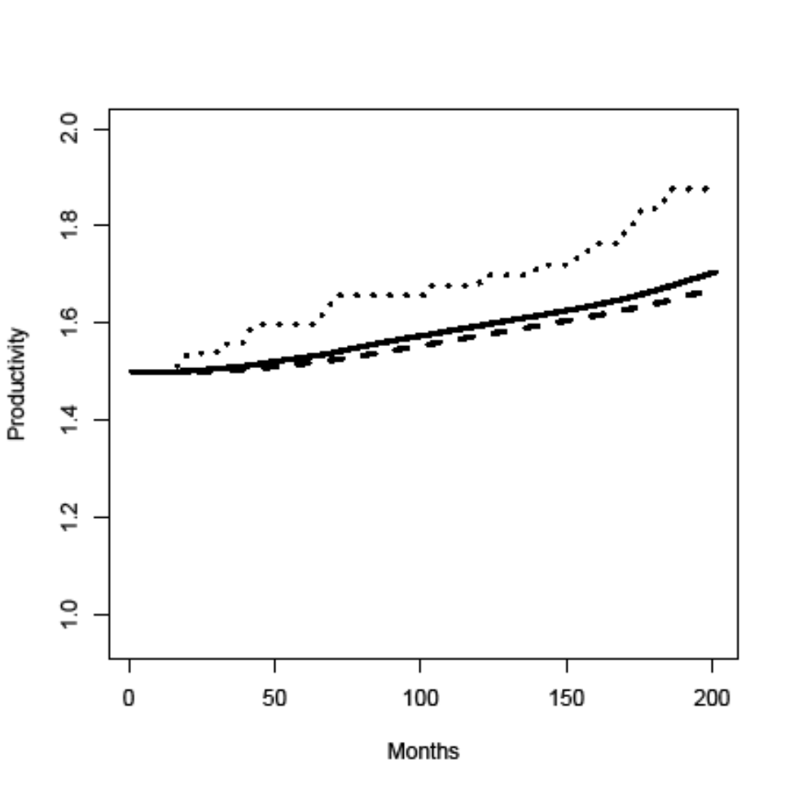
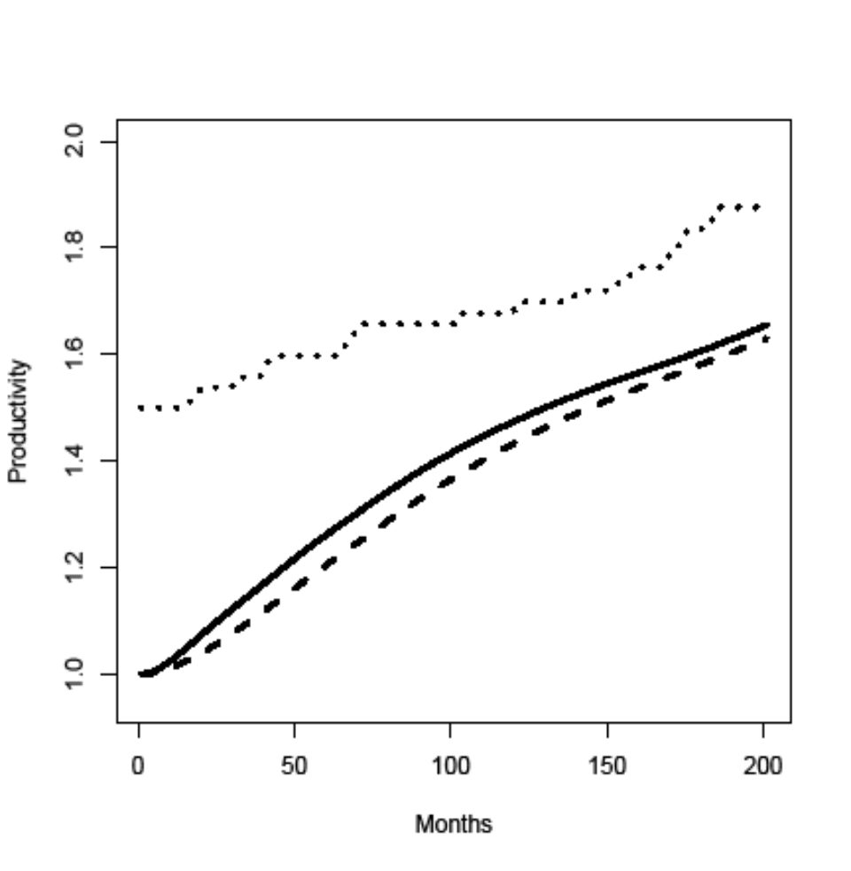
Comparison of identical HC Policies
old member new member
Average specific skills for high (solid) and medium (dashed) general skills

Slide 15
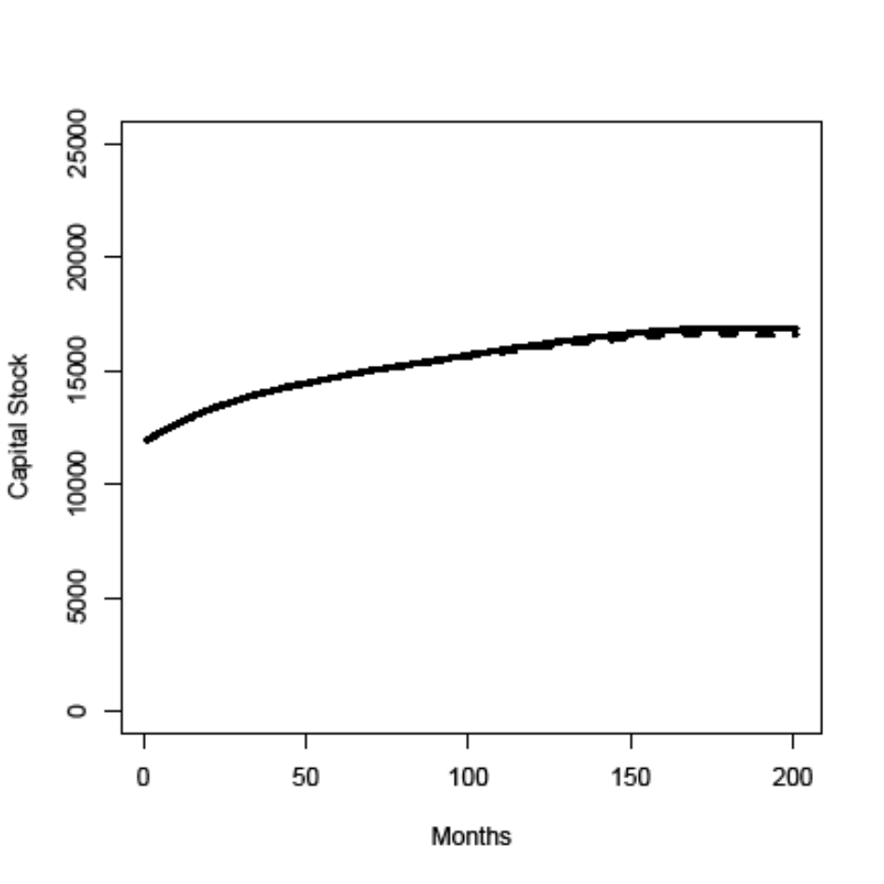
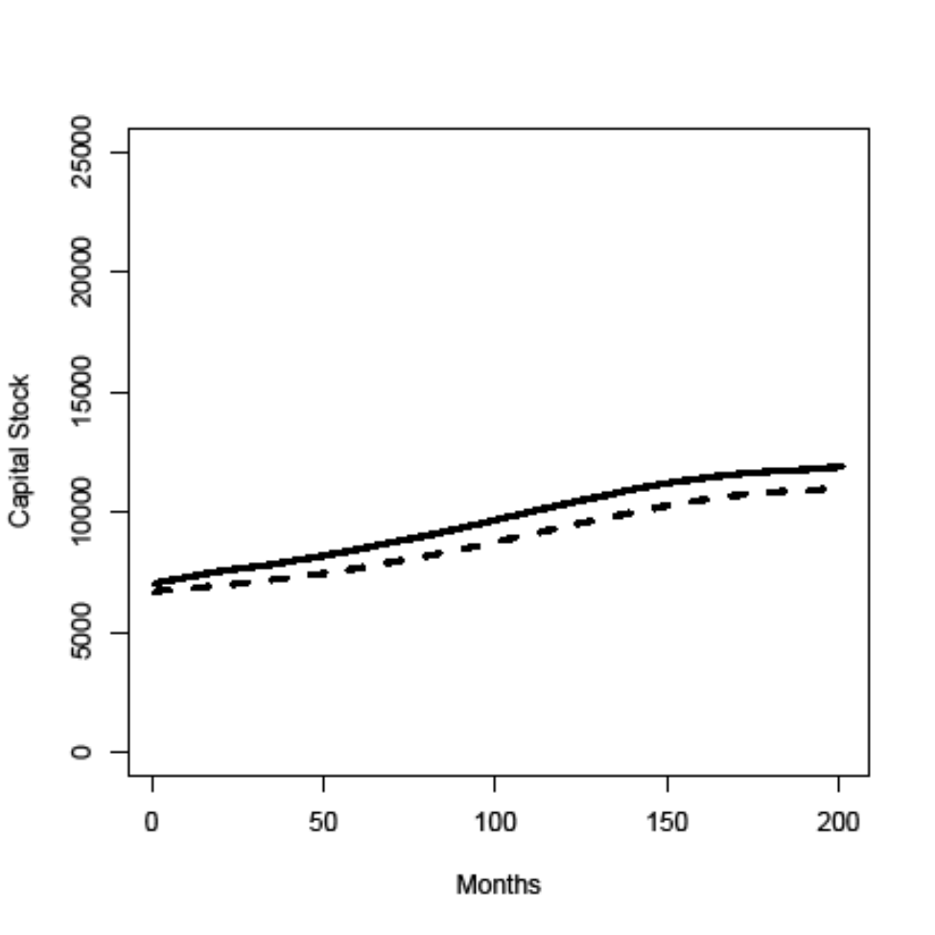
Comparison of identical HC Policies
old member new member
Physical capital stock: high (solid) and medium (dashed) general skills

Slide 16
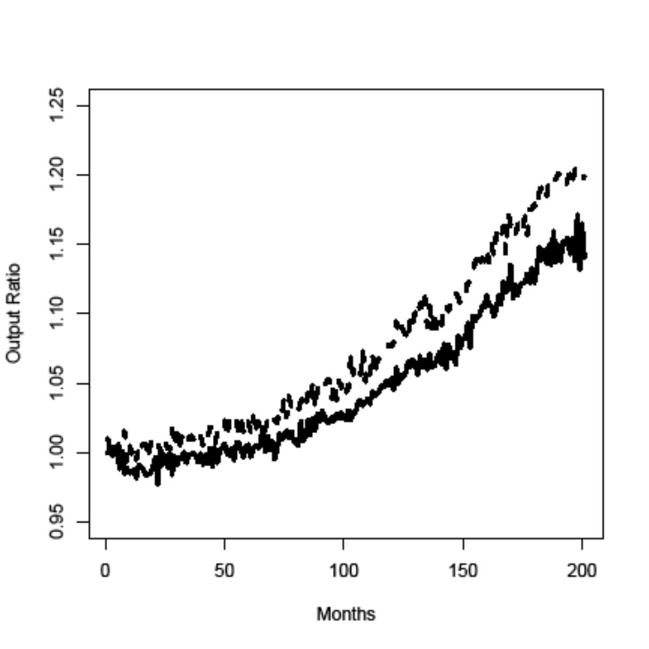
Effects of R&D Policy if gap in general skill levels has been closed
old member (solid)
new member with medium general skill level (dashed)

Slide 17
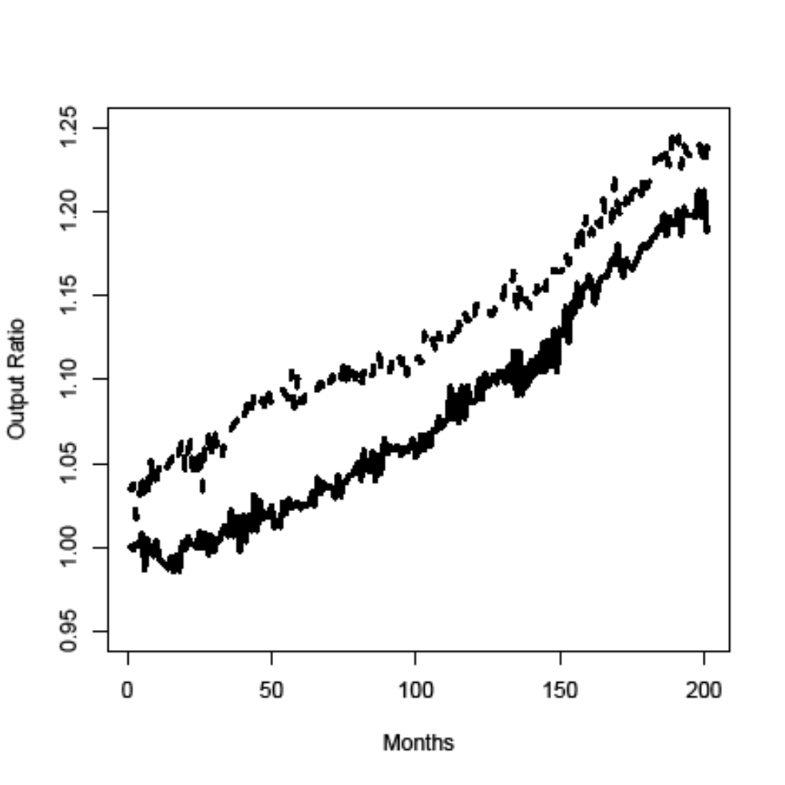
Combination of Policy Measures
R&D + HC (medium->high) policy:
old (solid), new (dashed) member

Slide 18
Conclusions
The agent-based EURACE macro-model has been used to explore several issues directly relevant to the Lisbon strategy.
Distance to frontier plays an important role for importance of HC vs. R&D policy, but more refined consideration of the reason for the gap is needed.
Differences in policy effects between old and and new members depend qualitatively on cosidered time-horizon.
Link between demand effects and diffusion of new technologies matters (although ignored in standard new growth models)

